Slide 1



Checkpoint Database
Najwa chaarana

Slide 2
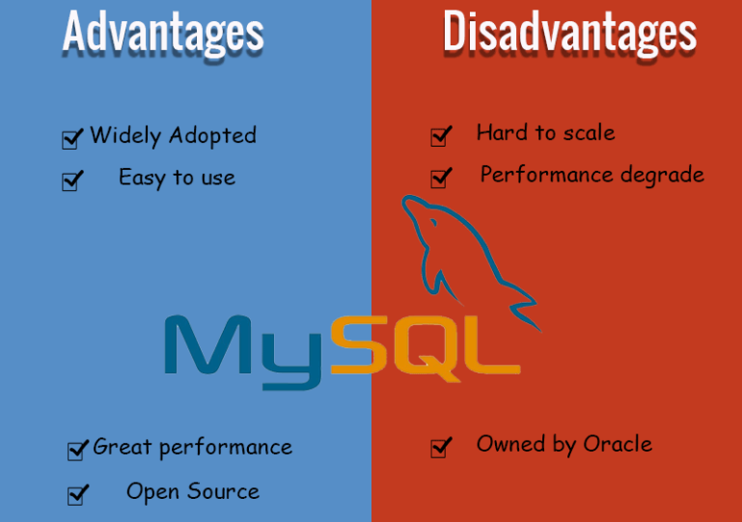
MySQL MySQL, the most popular Open Source SQL database management system, is developed, distributed, and supported by Oracle Corporation.
MySQL is a database management system.
MySQL databases are relational.
MySQL software is Open Source.
The MySQL Database Server is very fast, reliable, scalable, and easy to use.
MySQL Server works in client/server or embedded systems.
A large amount of contributed MySQL software is available.
Easy to interact with
MySQL has great performance
Stored procedure and trigger is limited
MySQL is hard to scale
MySQL is not for large sized data
MySQL is not fully compliance to standard SQL

Slide 3
- PostgreSQL is a powerful, open source, object-oriented relational database management system that is capable of securely supporting the most complex data workloads. Organizations that want to maintain a high level of data integrity and customization typically choose Postgres because of its reliability, data integrity, robust functionality, and because it provides consistently high performance and innovative solutions. - PostgreSQL runs on all major operating systems and has been ACID compliant since 2001. Commonly supported objects include views, stored procedures, indexes, triggers and object-defined data types, in addition to general RDBMS features such as primary keys, foreign key relationships and atomicity. Getting started with using PostgreSQL has never been easier - pick a project you want to build, and let PostgreSQL safely and robustly store your data.
PostgreSQL

Slide 4
PostgreSQL
Advantages
Easy to use.
Has a user-defined data type.
Open-source.
A lot of community support.
Make use of Stored procedures.
It supports ACID, i.e. Atomicity, Consistency, Isolation, Durability.
Disadvantages
Suppose we see the architecture of Postgre (Structured query language). The above diagram creates separate services for every client, which turns into a lot of memory utilization.
If we make a comparison, PostgreSQL is not good when it comes to performance.
It is not much popular than other database management systems.
This also has a lack of skilled professionals.
When it comes to speed, PostgreSQL is not worthy as compared to other tools.
Making replication is more complex.
Installation is not easy for the beginner.

Slide 5
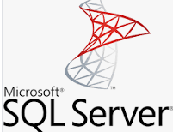
SQL server
SQL Server is a database server by Microsoft.
The Microsoft relational database management system is a software product which primarily stores and retrieves data requested by other applications. These applications may run on the same or a different computer.
Going more in-depth, in order to understand what a SQL Server is, you must first understand what SQL is.
SQL is a special-purpose programming language designed to handle data in a relational database management system. A database server is a computer program that provides database services to other programs or computers, as defined by the client-server model. Therefore, a SQL Server is a database server that implements the Structured Query Language (SQL).

Slide 6
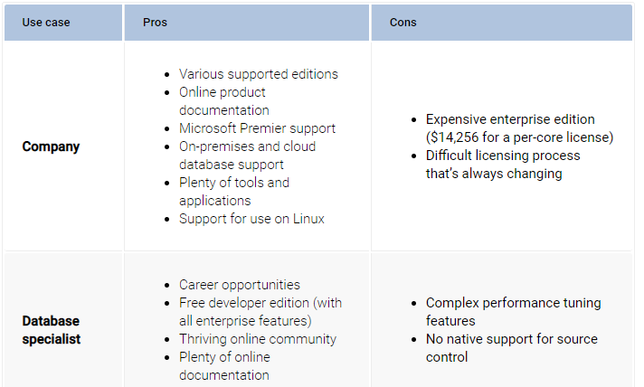

Slide 7

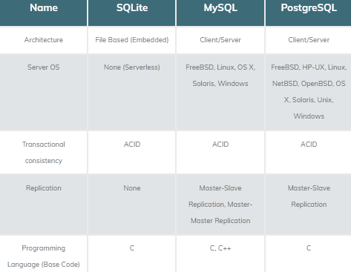
Comparison RDBMS

Slide 8
